Slide 1
Replication and Open Science: Survey Study

Slide 2
Research Question
RQ1: What is the state of reproducibility/replicability and open science across disciplines?
RQ2: What are the challenges researchers face in 2023 to replicate other studies in different research domains? What are the potential changes/incentives needed to implement open science and replication?
RQ3: How does cultural diversity vary across countries and different research areas when it comes to open science and good research practices?

Slide 3
Methods
This is a survey-based study.
It has closed-ended and open-ended questions.
The open-ended questions are analyzed using thematic analysis.
The closed-ended questions are analyzed using descriptive statistics.
We used Google Forms for this and distributed this survey by emailing all the professors across India and USA. We sent this survey to more than 3,000 faculties and were able to get 365 responses. All the responses currently are not used.
72 surveys from India and 249 surveys from the USA we filter out.

Slide 4
Research Domains
Computer science (36 responses)
Engineering (38 responses)
Psychology (49 responses)
Sociology (53 responses)
Political Science (30 responses)
Marketing and Economics (43 responses)
Others (Education and Biomedical- 23 responses)
Total we have 249 responses excluding “Others”

Slide 5
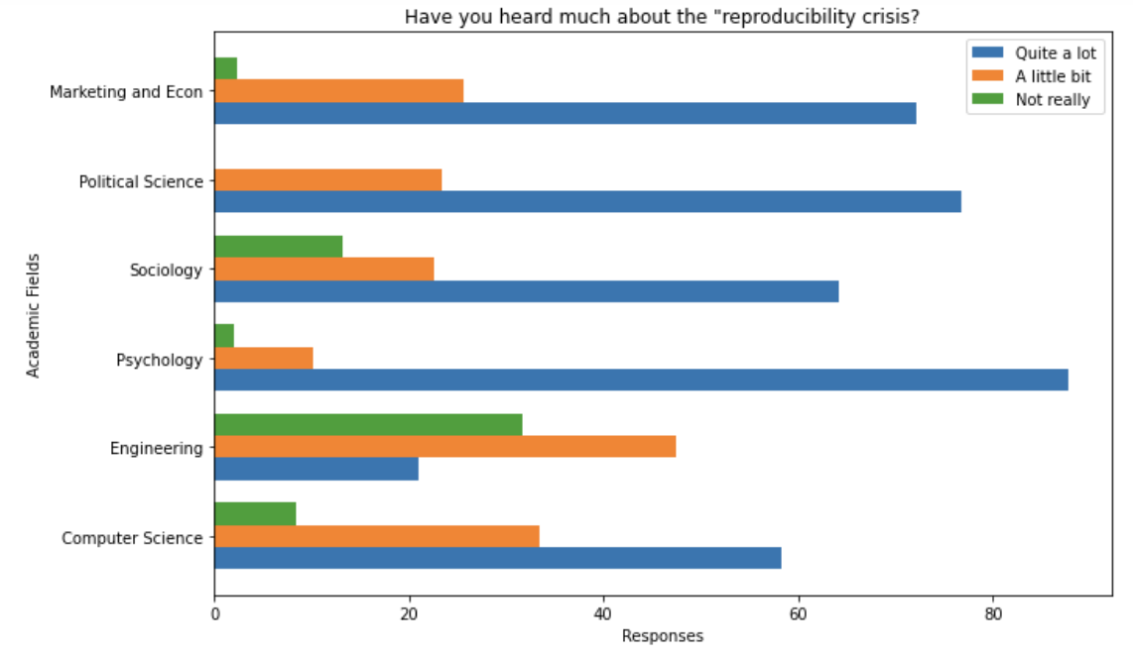
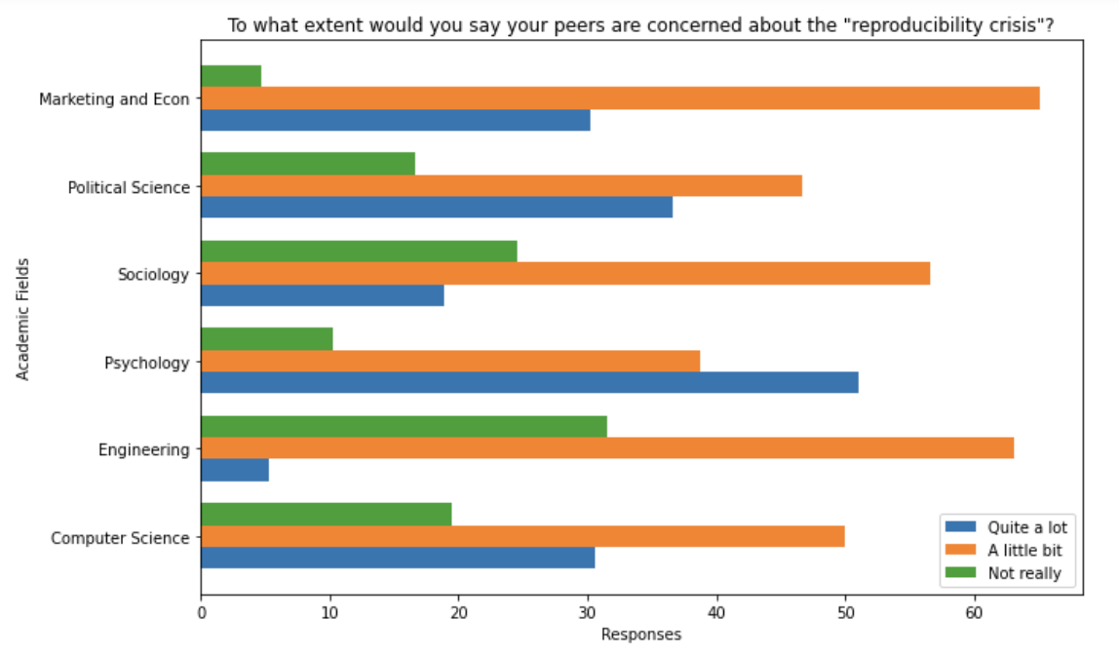
Overall, more than 90% of people are aware of
the reproducibility crisis in Scientific Research.
Engineering has the least awareness regarding the reproducibility crisis.
More than of the total population are little
concerned about the scientific crisis.
The psychology department has the highest
concern regarding this issue.

Slide 6
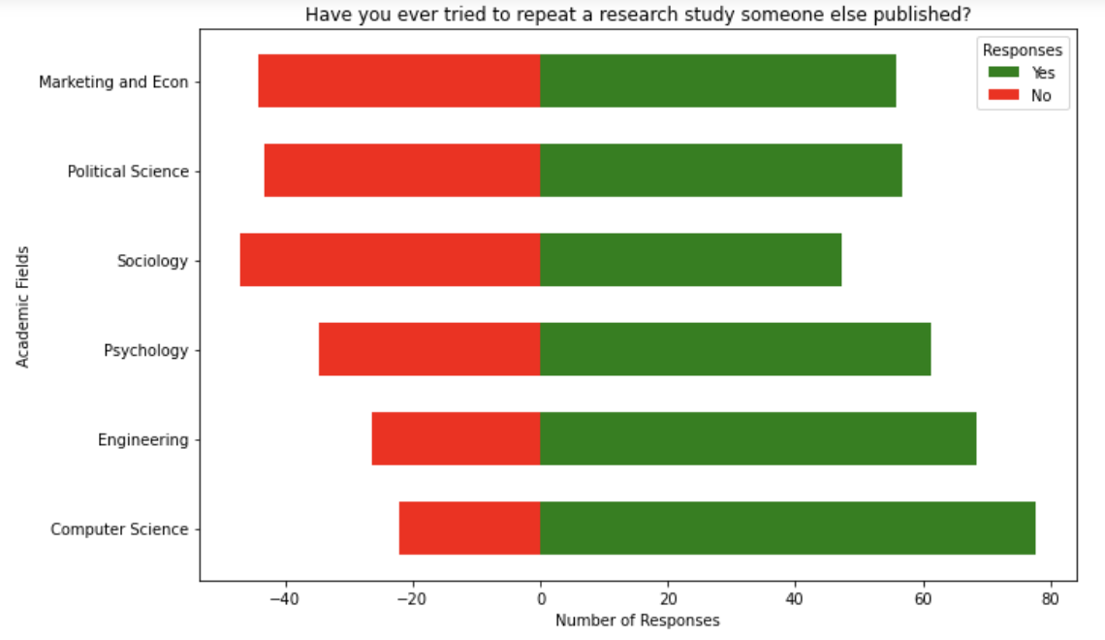
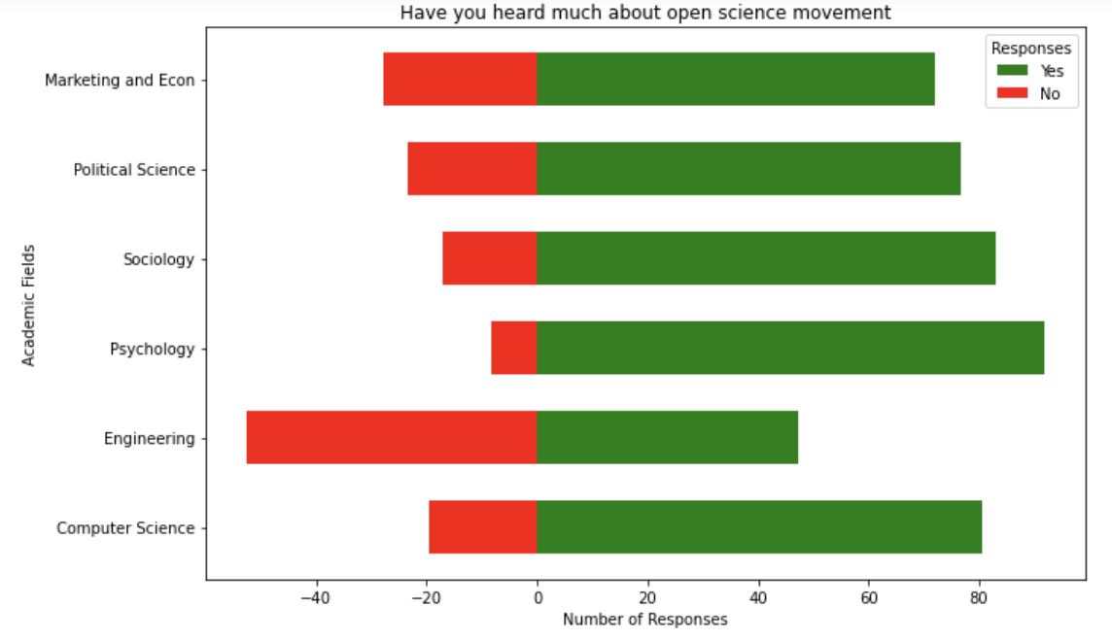
Although the engineering domain has the least awareness
about reproducibility crisis, more than 60% of them
have tried to repeat other works.
76.3% of respondents know about the open science
movement.
Engineering researchers are least aware of the open science
movement. More than 52% of the respondents never heard
about the open science movement.

Slide 7
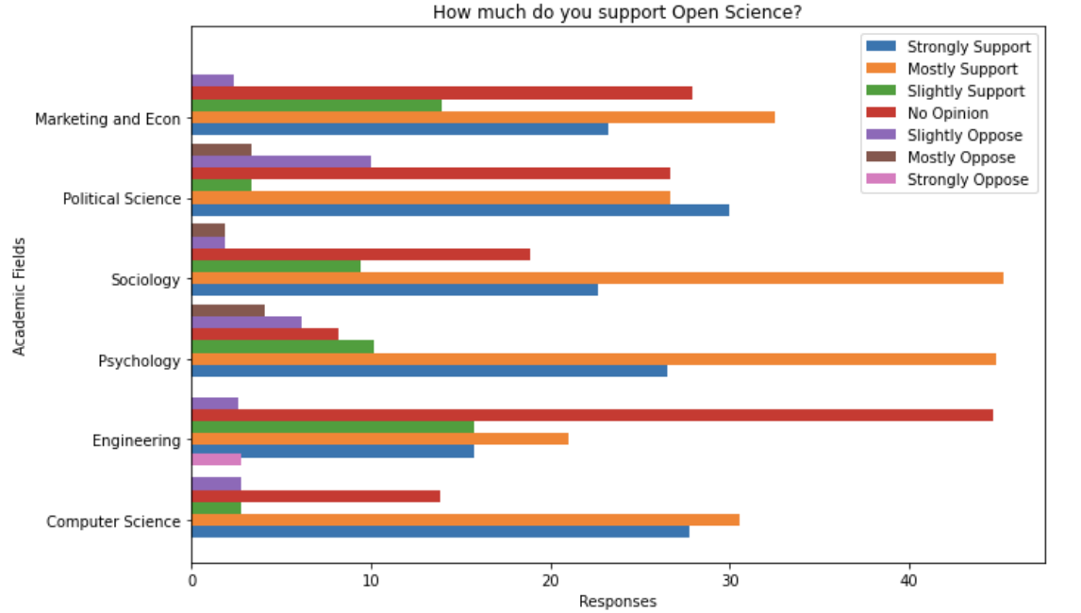
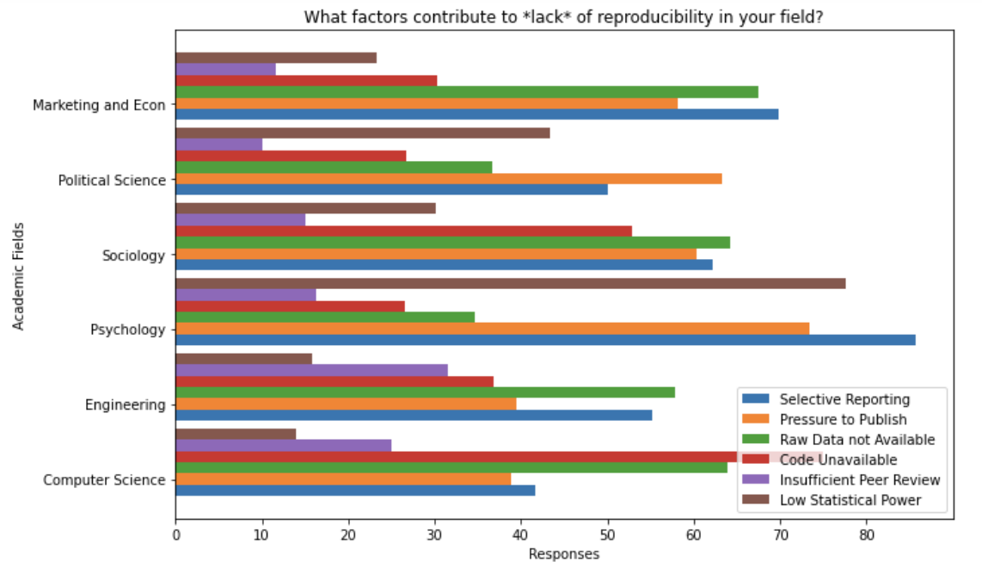
Overall, 68.67% of respondents support open science.
22.48% of respondents have no opinion of Open Science.
Psychology and Sociology have the highest support
for Open Science.
What factors contribute to *lack* of reproducibility in your field? (select all that apply) | Computer Science (36) |  | Engineering (38) |  | Psychology (49) |  | Sociology (53) |  | Political Science (30) |  | Marketing Econ (43)
Selective reporting | 15 | 41.66666667 | 21 | 55.26315789 | 42 | 85.71428571 | 33 | 62.2641509 | 15 | 50 | 30 | 69.76744186
Pressure to Publish | 14 | 38.88888889 | 15 | 39.47368421 | 36 | 73.46938776 | 32 | 60.3773585 | 19 | 63.33333333 | 25 | 58.13953488
Raw Data not available | 23 | 63.88888889 | 22 | 57.89473684 | 17 | 34.69387755 | 34 | 64.1509434 | 11 | 36.66666667 | 29 | 67.44186047
Code unavailable | 27 | 75 | 14 | 36.84210526 | 13 | 26.53061224 | 28 | 52.8301887 | 8 | 26.66666667 | 13 | 30.23255814
Insufficient Peer Review | 9 | 25 | 12 | 31.57894737 | 8 | 16.32653061 | 8 | 15.0943396 | 3 | 10 | 5 | 11.62790698
Low Statistical Power | 5 | 13.88888889 | 6 | 15.78947368 | 38 | 77.55102041 | 16 | 30.1886792 | 13 | 43.33333333 | 10 | 23.25581395

Slide 8
What factors contribute to *lack* of reproducibility in your field? (select all that apply)
Time and Cost are a Big challenge which is difficult to solve – ‘Some of the research in my field involves very large investments (e.g., testing social interventions, long term follow up of samples) that do not lend themselves to easy reproducibility. They can take 15 + years to collect the data and multiple millions of dollars in funding. ’
Missing Information and Selective Information – ‘not enough specific information in the publication’, ‘Training datasets are nowadays kept private’, ‘incomplete methods, failing to report studies that did not work’
Lack of Proper Training - I am not sure if this falls under "selective reporting" but I think leaving out small details of methods that the authors may not realize are important, or the journal doesn't include due to space. ---
No proper incentive – ‘Limited incentives to undertake replication or re-do of existing work.’

Slide 9
sloppy work and fraud
Interesting – ‘Reproducibility is a silly concept and it should not be a goal in social inquiry’,
“It's not a concern in qualitative sociology.” / “Qualitative research is hard to "reproduce" given the time constraints associated with its inception. ”
“NSF did not want to support reproductions even with additional variations.”
“Top journals (unsurprisingly) want creative arguments and novel findings.”
“Could open code fix that? Sure, but we're talking about missing value code-level mistakes. People just need to learn how to code.”
“Pressure on Editors to publish new pathbreaking articles.”

Slide 10
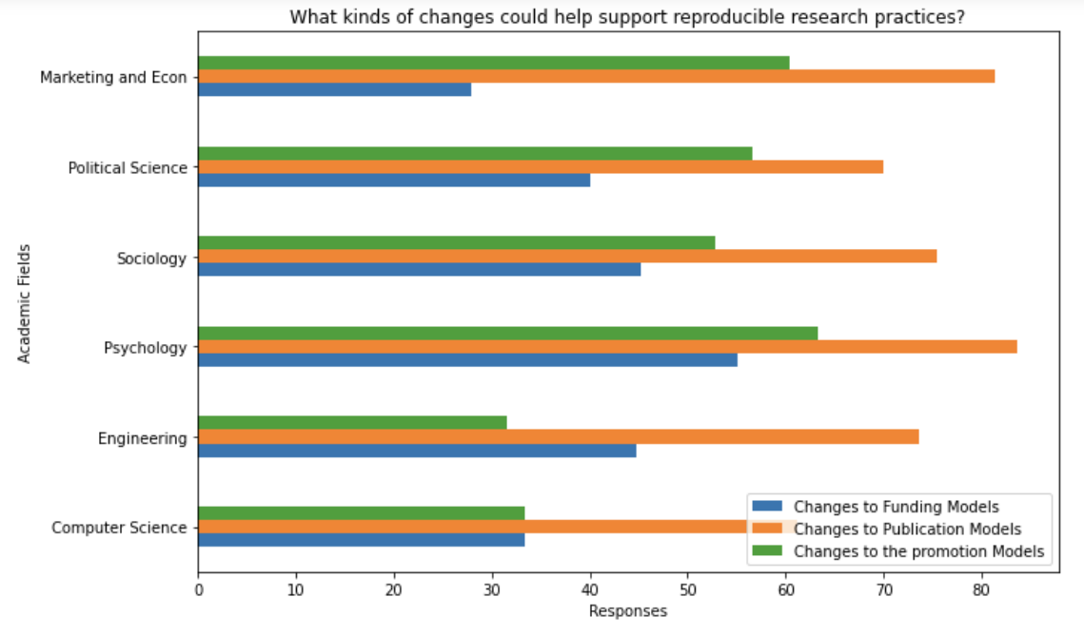
Total(%) India |  | Total(%) USA
Promotion- 47.22 | 126 | 50.60241
Funding- 54.16 | 104 | 41.76707
Publication 81.94 | 187 | 75.1004
What kinds of changes could help support reproducible research practices? | Computer Science (36) |  | Engineering (38) |  | Psychology (49) |  | Sociology (53) |  | Political Science (30) |  | Marketing Econ (43)
Changes to funding models | 12 | 33.33333333 | 17 | 44.73684211 | 27 | 55.10204082 | 24 | 45.2830189 | 12 | 40 | 12 | 27.90697674
Changes to publication models | 22 | 61.11111111 | 28 | 73.68421053 | 41 | 83.67346939 | 40 | 75.4716981 | 21 | 70 | 35 | 81.39534884
Changes to promotion and tenure models | 12 | 33.33333333 | 12 | 31.57894737 | 31 | 63.26530612 | 28 | 52.8301887 | 17 | 56.66666667 | 26 | 60.46511628

Slide 11
What kinds of changes could help support reproducible research practices?
Reviewers should pay closer attention to whether all details are released.
Enabling full publication of all the details.
The review and publication process should really be focusing on the rigor of the methods, not the significance of the results; with valid and generalizable methods, insignificant/unexpected results are still important, they means we thought it wrong
methods reporting standards with journals
pre=publication code review & sensitivity analysis
None of these are going to matter much, need to change the review model.
Availability of data and code used in experimental research could be the norm
Transparency in research practices and data
This cannot be solved!
More emphasis on accuracy and expertise, much less emphasis on the "H index" and complete avoidance of the so-called "High Impact Journals" which are mainly a magazine style of publishing by private companies like Nature and Cell Press.
It's truly a matter of integrity; guidelines can help, training in integrity can help more
Not pushing the idea that all novel work must be surprising or disconfirming previous folk understanding of an issue.
How were questionnaires administered, what were instructions to participants in imaging study, what were tasks really like and where were they administered and by whom, etc

Slide 12
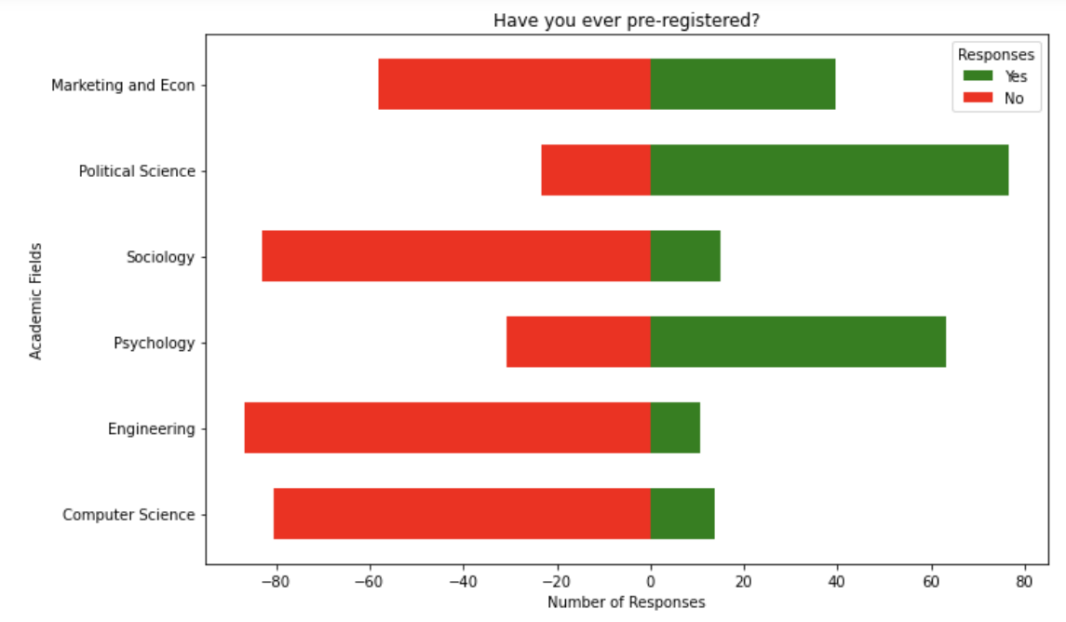
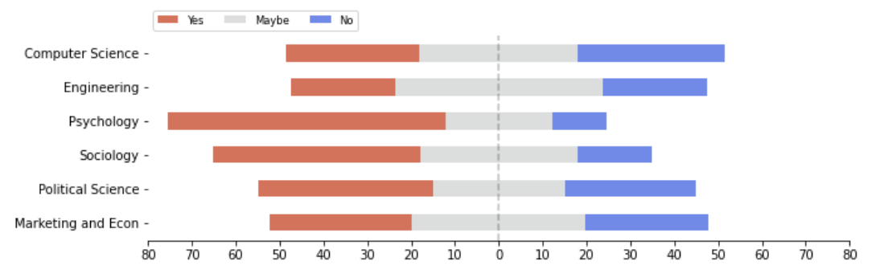
Responses for the pre-registration are very interesting.
Political Science and Psychology mostly care about the
pre-registration but the remaining departments do not much
care about it.
Overall, more than 60% of respondents never preregistered.
Should coursework on reproducibility and open science be a part of undergraduate curriculum?
More than 63% of respondents from the psychology
respondents support integrating reproducibility and
open science in coursework.

Slide 13
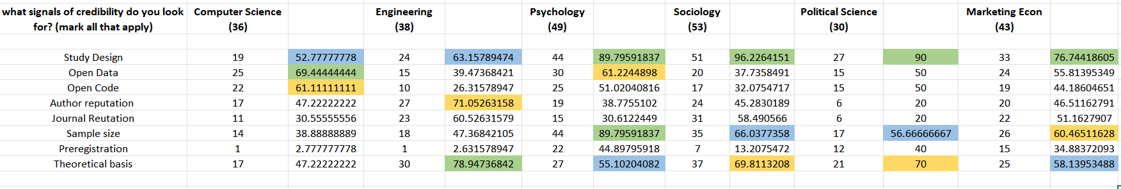
what signals of credibility do you look for? (mark all that apply)

Slide 14
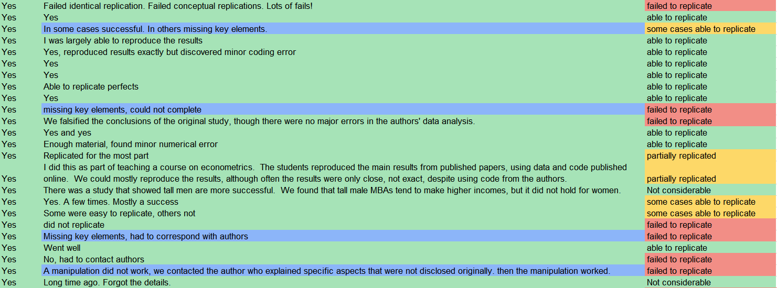
If you tried to replicate, Did you have enough information and materials to repeat the study or were you missing key elements? If you were able to repeat the study, was your reproduction/replication result affirmative? (Open Ended Question)

Slide 15
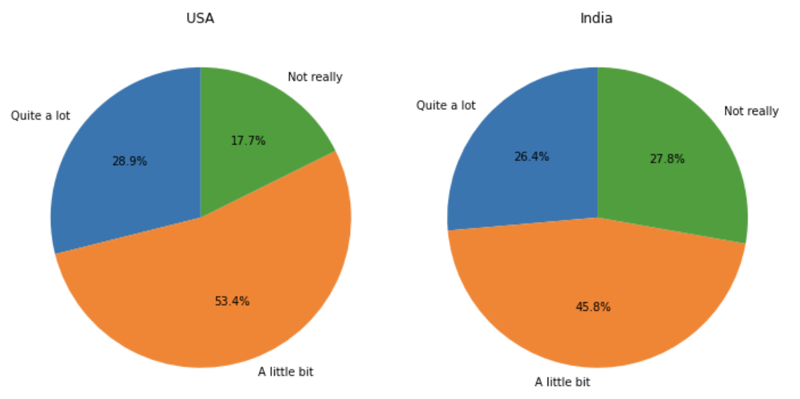
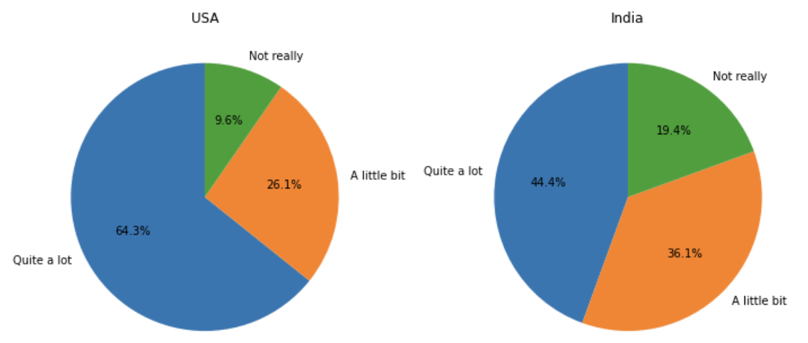
Have you heard much about the "reproducibility crisis"?
To what extent would you say your peers
are concerned about the "reproducibility crisis"?

Slide 16
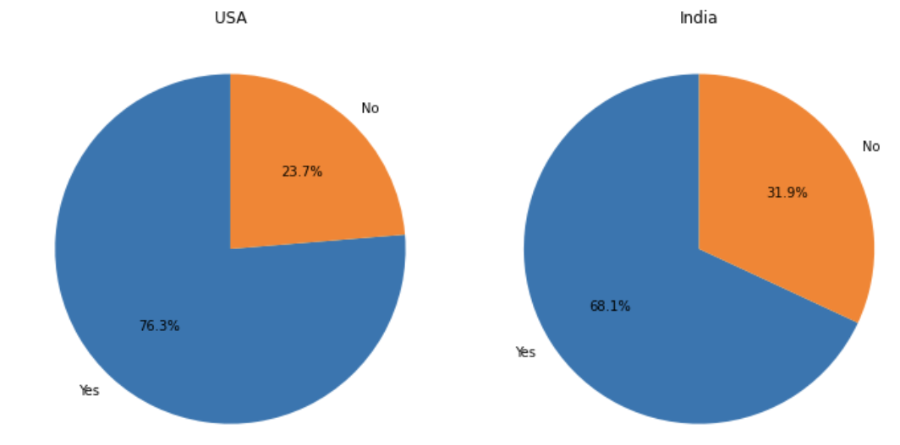
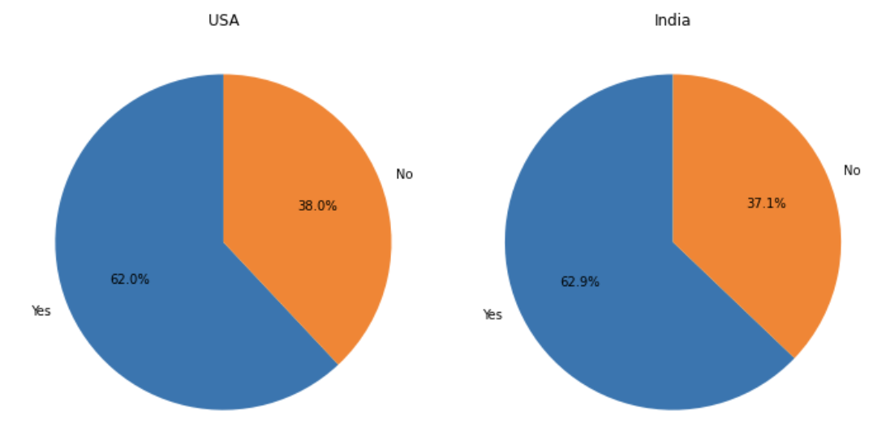
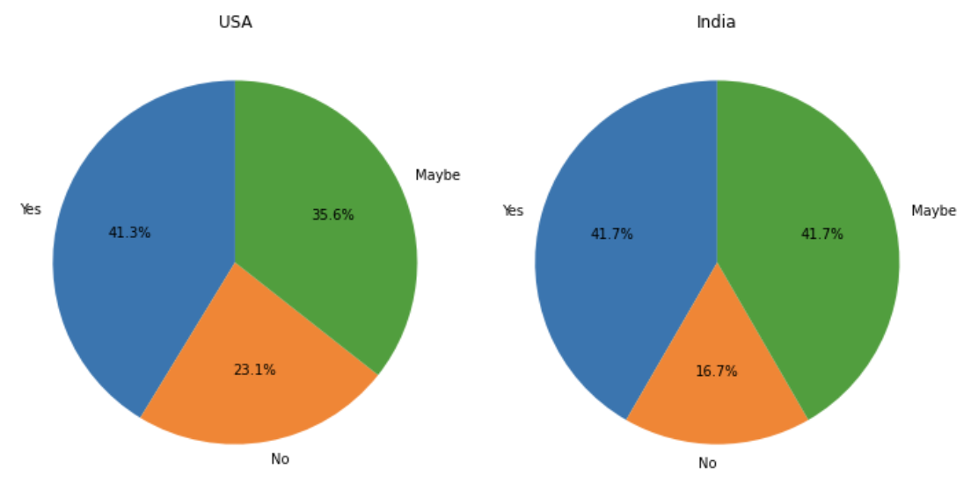
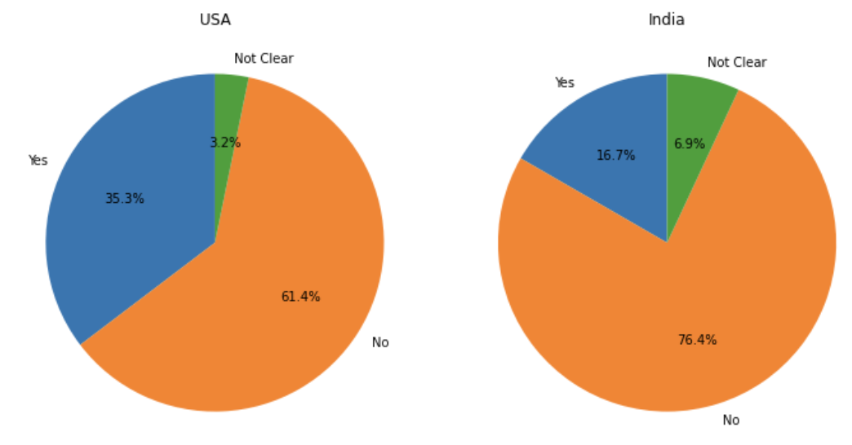
Have you ever tried to repeat a research
study someone else published?
Have you heard much about the "open science" movement?
Should coursework on reproducibility and open science
be a part of undergraduate curriculum?
Have you ever pre-registered a study?

Slide 17
Future Work Directions for My work are as follows:
What are current measures taken by journal editors and conference chairs to ensure that peer review processes function as intended, namely, to identify reproducible, replicable, and robust scientific findings? --- Peer Review
What kinds of AI-driven tools might best support peer review and dissemination processes? – Peer Review
How to integrate Open Science in Coursework of undergraduate and graduate students? – Integration to CourseWork

Slide 18
Thank You

